Slide 1
Create More Inclusive Classrooms with Microsoft 365 Education Malavika Rewari Microsoft 365 Marketing @MalavikaRewari Megan Lawrence Microsoft Accessibility @accessgeo

Slide 2

US Classrooms are Diverse
99% of teachers have students who need assistance/intervention for social, emotional, or behavioral reasons in their classroom.​
73% of teachers have students with reading levels that span four or more grade levels in their classroom.​
72% of teachers have special education students in their classroom.​
52% of teachers have English language learners in their classroom.
Notes:
Source: http://www.scholastic.com/primarysources/teachers-on-teaching.htm

Slide 3

Unlocking limitless learning begins with access
“Students would rather go without, than stand out. We need to move from assuming access to ensuring access in classrooms.”
- Robin Lowell, Special Education Teacher who lead Aka.ms/AccessibleContentTraining
Notes:
Source: http://www.scholastic.com/primarysources/teachers-on-teaching.htm

Slide 4




Accessible technologies help students across the disability spectrum unlock their full potential by addressing a diversity of needs
Andrew, a young boy with dyslexia read for the first time before entering 3rd grade with the aid of Microsoft Learning Tools.
Veronica, a student who has low vision uses accessibility capabilities in Office 365 and Windows 10 to excel academically
Justin, a student with cerebral palsy uses technology as his voice and Office 365 for classroom and public speaking presentations.
Jack teaches students at the Louisiana Center for the Blind to create high-quality visual content with Office 365 and Windows 10.

Slide 5



Explore Microsoft Education tools with built-in accessibility to build a strong foundation for success
Empower teachers to engage every learner
Enable students to grow their potential
Ensure schools promote equity and inclusion

Slide 6
“No one should have to ask for access, it should just be there.”
- Marlee Matlin
Academy Award Winning Actress
Outside In Talk at Microsoft
December 2016

Slide 7
Engage every learner by making classroom content accessible with Office 365
AUDIO ACCESSIBILITY
VISUAL ACCESSIBILITY
TEXT ACCESSIBILITY
Add closed captions for audio/video in PowerPoint and Sway
Get automatic live captions for PowerPoint via Microsoft Garage Presentation Translator add-in
Get automatic audio transcription for videos in Microsoft Stream.
Add alternative text descriptions to visual objects in all apps
Get automatic alt-text for images in Word and PowerPoint
Record narrations of PowerPoint slides and embed audio recordings in OneNote and Sway
Transform printed text into searchable Office files with OCR via Office Lens
Make content easy to navigate with built-in accessible Styles
Make hyperlinks more readable by adding display names, auto-generated for Recent Items in Link Gallery
ACCESSIBILITY CHECKERS
ACCESSIBLE TEMPLATES
EXPORT AND EMAIL ACCESSIBILITY SETTINGS
In Office PC, Mac and Online apps to easily find accessibility issues
With detailed guidance to fix issues
For Word, Excel and PowerPoint to get started on the right track
Searchable by keyword “accessible”
Export as tagged PDFs from Office
See MailTips prior to sending emails to those who prefer accessible content

Slide 8
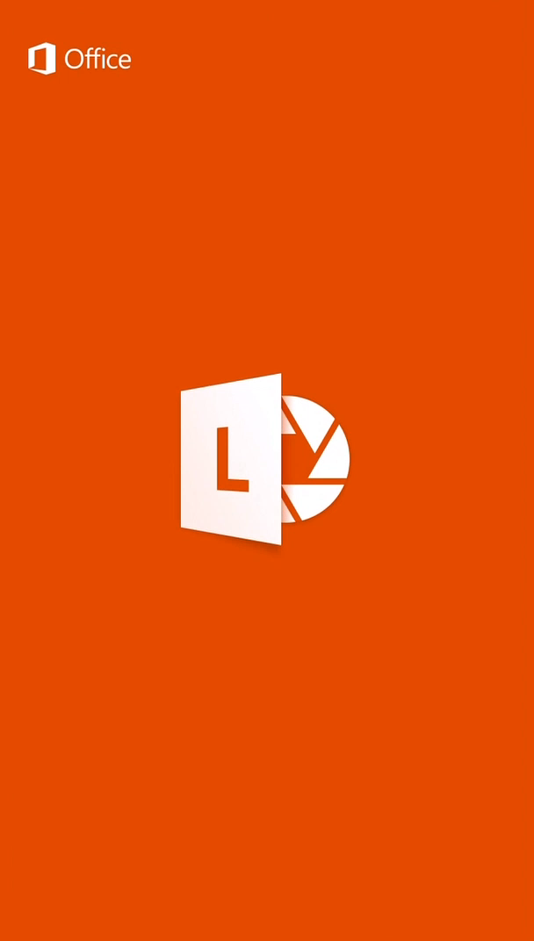
Office Lens and the Immersive Reader

Slide 9

Chinook Middle School’s Story
“When I walked away to the other end of the room, translator still can catch the speaker. I have bad hearing and I could not hear clearly what the speaker said from the distance, but translator helped me to catch what I was missing.” – A Parent
Chinook Middle School has a diverse student and parent community and they recently used Microsoft Translator for Education to engage a multilingual audience.

Slide 10
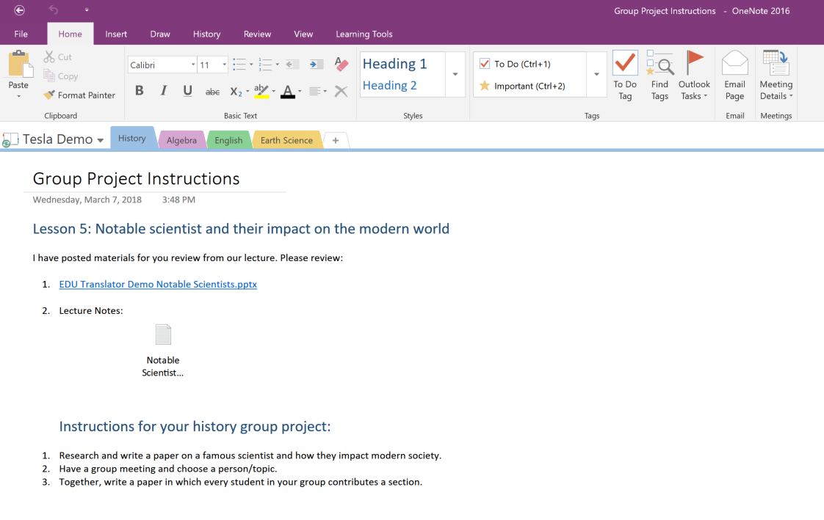
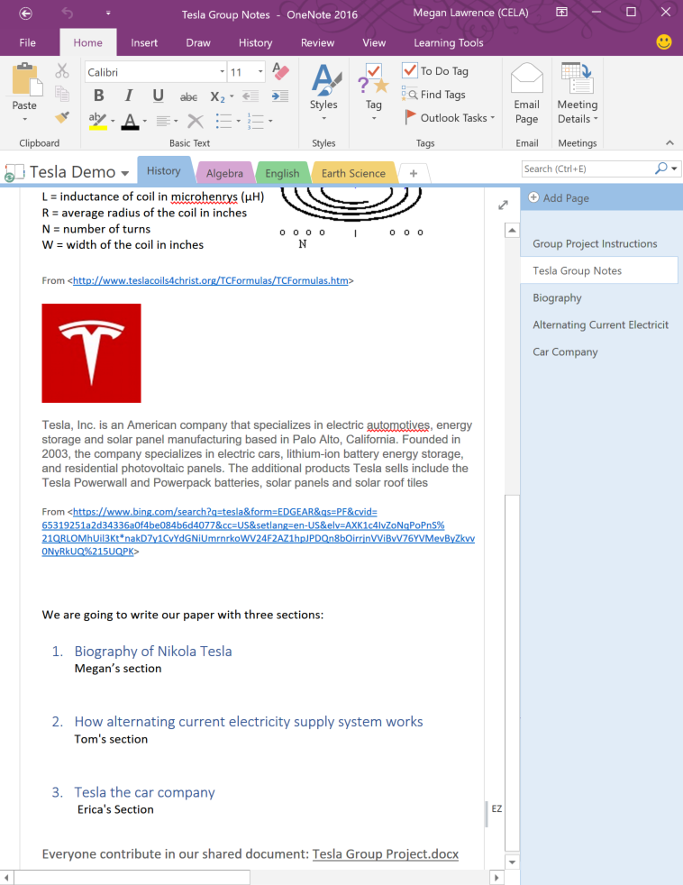
Collaborate inclusively in diverse teams with Office 365
Classroom Notebooks with teachers and students
Teachers add lesson plans, PowerPoint, and transcripts, etc.
Students collect notes in one location and link to shared documents.

Slide 11



Work efficiently and independently with Office 365 and Windows 10
Built-in accessibility solutions from Microsoft help reduce the stigma of learning challenges and provide students with the tools they need to fully engage with their curricula, classmates, and teachers in powerful new ways.
Read
Learning Tools
Color Filters
Narrator
Write
Dictate
Inking
Keyboard

Slide 12
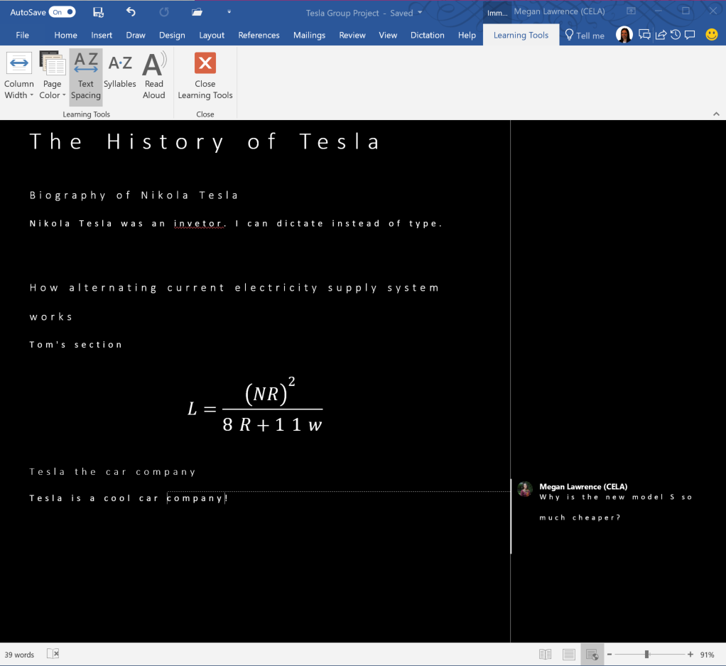
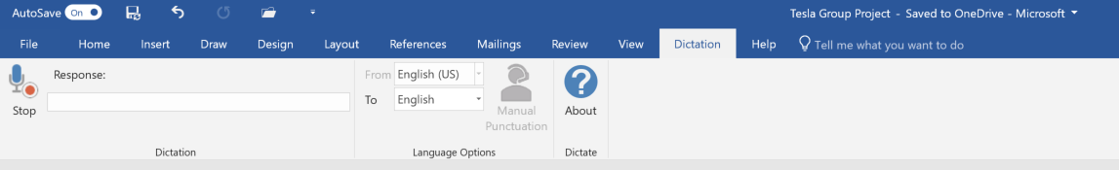
Learning Tools and Dictation
Customizes reading view
Read aloud with immersive reader
Add content with dictation

Slide 13
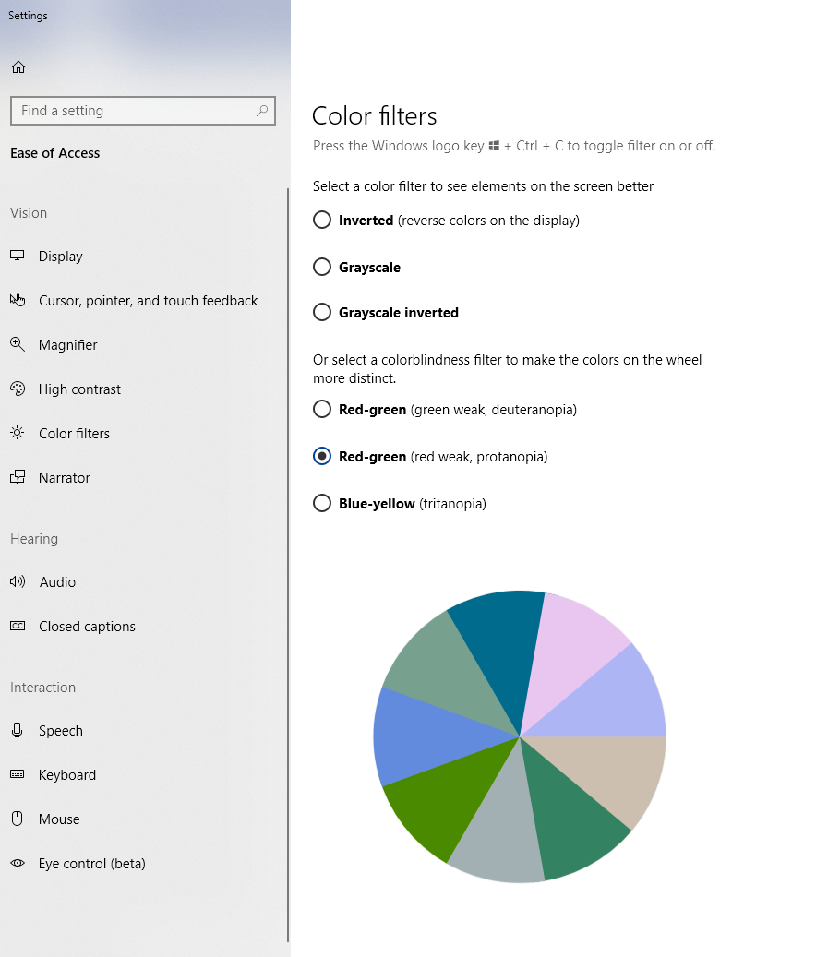
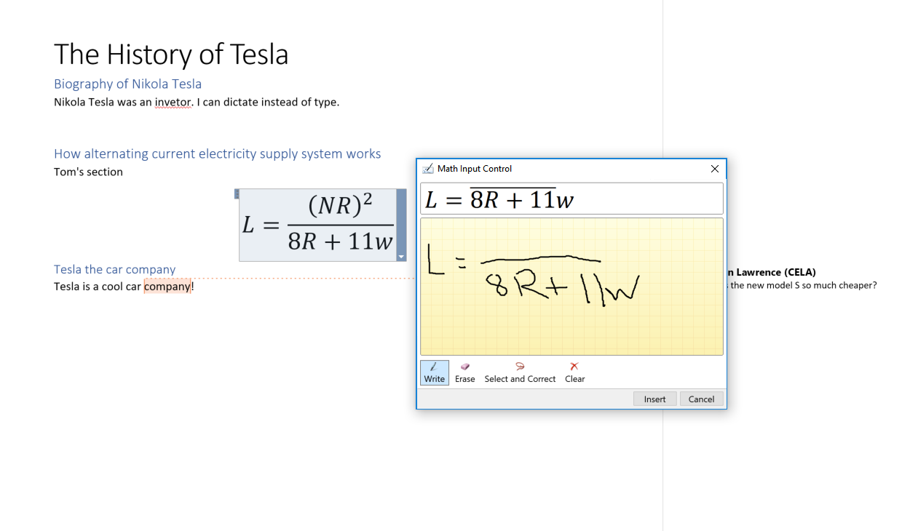
Color Filters and Inking
Navigate and access content with screen reader
Add new content with keyboard
Read and reply to comments

Slide 14
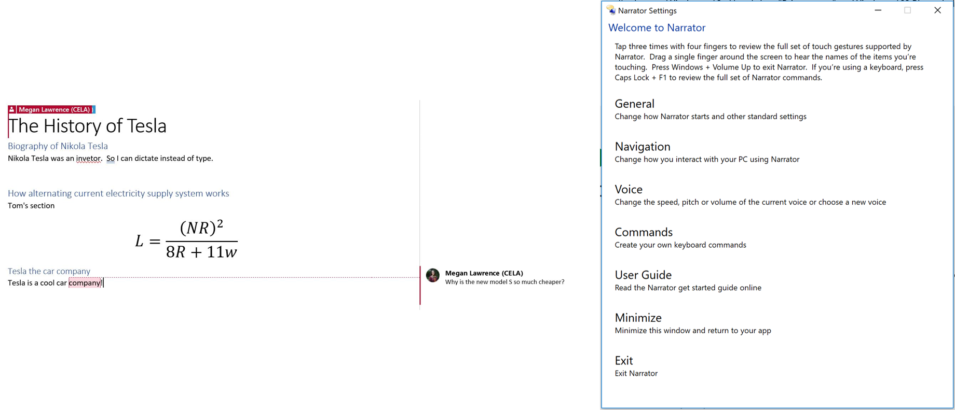
Narrator and Keyboard
Navigate and access content with Narrator
Add new content with keyboard
Read and reply to comments

Slide 15
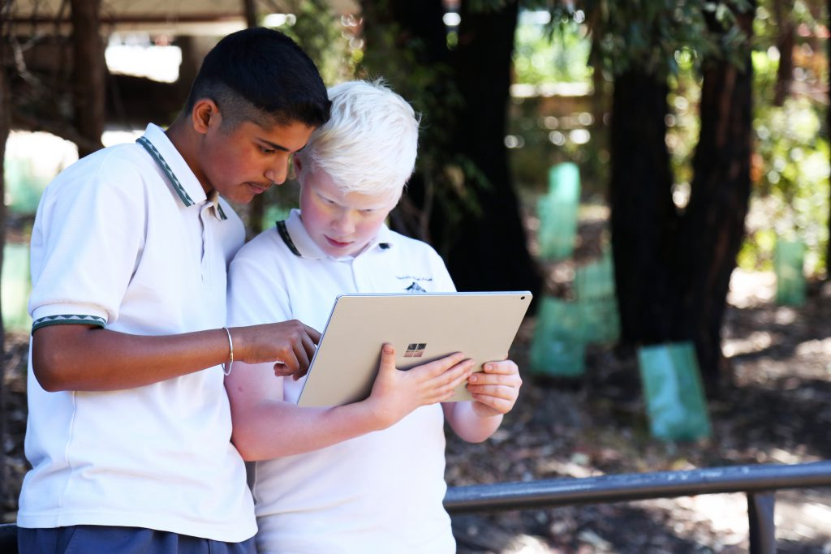
Ulladulla High School Student’s Story
“Group projects are really easy now. With Immersive Reader I’m able to change the way I read text to suit me – so I don’t hold anyone up. It’s really, really cool”
-Jacob
Jacob is a year 7 student in Ulladulla High School with a vision impairment whose teachers and peers use accessibility capabilities in Microsoft Office 365 to produce accessible classwork.

Slide 16
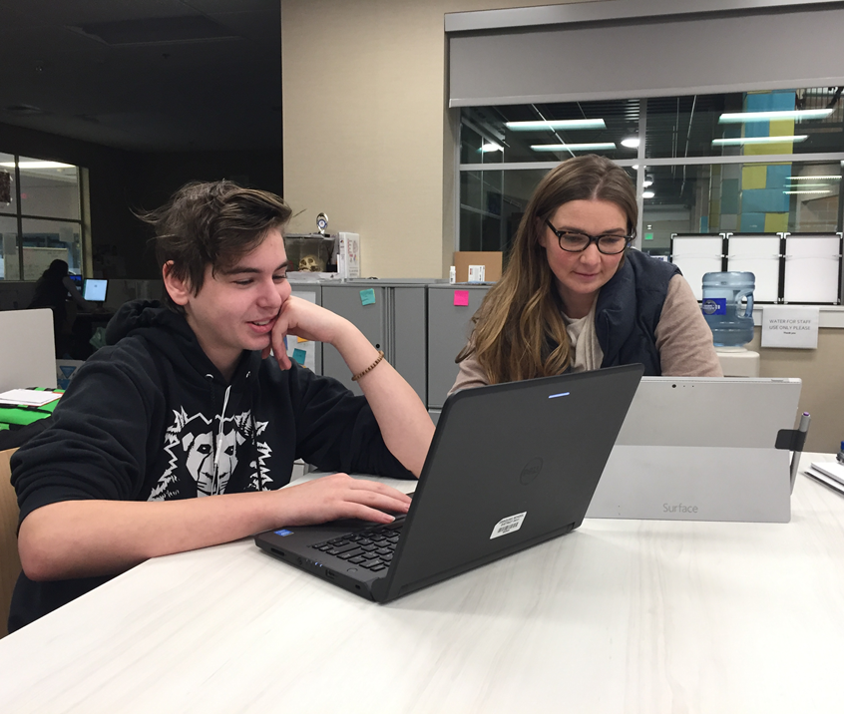
A Special Educator’s Experience with Editor
“I was working with a student (with dyslexia) who was trying to put together his resume. About 10 minutes in, he felt so defeated because his errors felt like roadblocks. He knew what he wanted to say, he just couldn’t get the words close enough and he wanted to give up.
This feature (Editor) opened a door for him, it allowed him to focus on the content and ideas he was trying to get down. The options and synonyms gave him independence to not have to ask, or have someone sit by him and coach him through the entire document.”
-Robin Lowell

Slide 17

Accessibility requires compliance and usability

Slide 18

Ensure compliance and inclusion in schools
Compliance and transparency are wins for teachers, students, and administrators, because time-consuming, costly investigations and compliance audits are not needed.
Microsoft tools and solutions meet global accessibility standards. We provide conformance statements for Section 508, EN 301 549, and WCAG 2.0 AA, verified by Trusted Testers.
Bottom line: Less time documenting means more time building an equitable learning environment—doing the work that directly benefits all of your students.

Slide 19
Learn more in Seaport Ballroom H
3/21 10am: Accessibility in Windows 10: What’s New
3/21 11am: What’s New in Microsoft Office 365
3/22 11am: Create Inclusive Classrooms with Microsoft Education
3/22 1.20pm: Microsoft Reading, Writing and Learning Tools
3/22 2.20 pm: Leveraging Seeing AI to Augment Visual Awareness
3/22 3.20pm: Excel 101 Tips and Tricks
3/22 4.20pm: Easily create accessible content with Office 365
3/23 11am: Create Engaging and Accessible Presentations with PowerPoint and Sway
3/23 2.20pm: How I used Microsoft OneNote to Manage a Medical Crisis

Slide 20
Additional Resources
Trainings for educators: aka.ms/AchievementForAll, aka.ms/AccessibleContentTraining and education.microsoft.com/GetTrained/accessibility
Help articles on accessibility: Aka.ms/OfficeAccessibility
Microsoft accessibility site: Microsoft.com/Accessibility
Twitter for news, insights, and updates: @MSFTEnable
Microsoft Presentations at CSUN: Aka.ms/CSUN2018
Accessibility support for organizations: Aka.ms/Edad

Slide 21







Try out the technologies yourself
Seeing AI, Office Lens, & Translator
Learning Tools
Dictate
Read Aloud
Editor
Take content from the analog to the digital world
Try it today! microsoft.com/en-us/seeing-ai Aka.ms/OfficeLens Aka.ms/TranslatorForEducation
Comprehension, fluency and decoding aids
Try it today! OneNote.com/LearningTools
Use voice to get your best thoughts into your documents
Try it today! Dictate.ms
Read your content with simultaneous word highlighting
Get it with Office 365. Aka.ms/OfficeEducation
Aka.ms/LearningTools
Write easy-to-read documents, with more confidence
Get it with Office 365. Aka.ms/OfficeEducation Aka.ms/Editor

Slide 22
We want to hear from you.
Connect with us in person today or anytime through our support and feedback channels.
Disability Answer Desk for phone/chat/ASL Help: Aka.ms/AccessibilitySupport
User voice Forum for Accessibility Feedback: Aka.ms/AccessibilityFeedback

